Slide 1
Ben Holleran
Introduction to GPIO Pins on the RaspberryPi

Slide 2
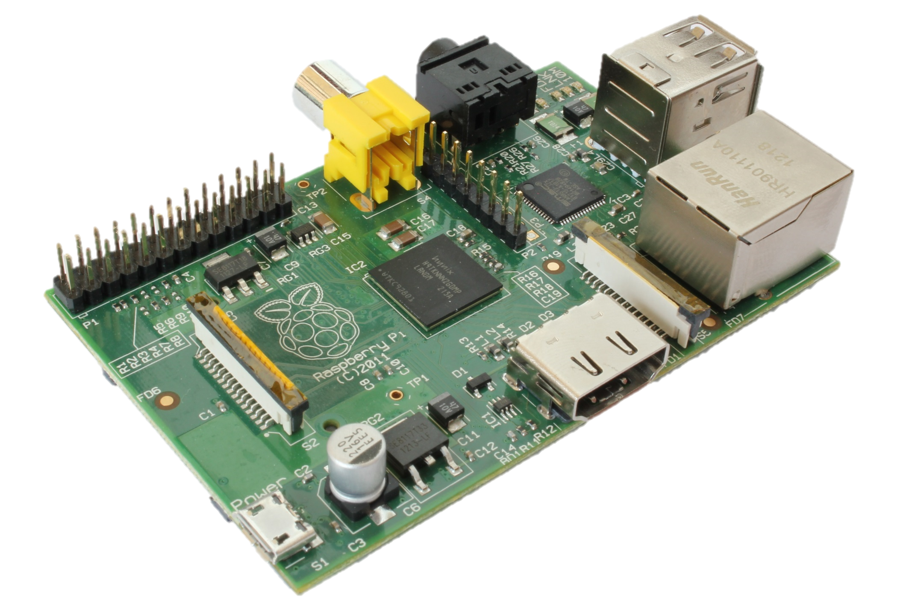
Raspberry Pi
Credit Card Size
ARM 700MHz
512MB RAM
$25
Raspbian
FreeBSD
Android 2.3 & 4.0

Slide 3
Hardware Specs
Broadcom ARM 700MHz
256 MB or 512MB RAM
Integrated Graphics Capable of 1080p
USB
Ethernet
HDMI
Audio
Video Out
SD Card Slot
GPIO Headers

Slide 4
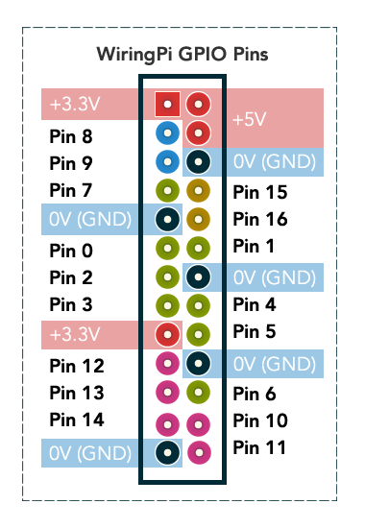
GPIO Header
General Purpose I/O
3.3V with no Overvoltage Protection
I²C | 8,9
SPI | 12,13,14
UART | 15,16
Full Port | Green

Slide 5
GPIO Header (Continued)
No built in ADC
One PWM pin
All others Software
Current Limits Absolute Max
Source 50mA
Sink 15mA

Slide 6
Example Code
Requires Rasbian, WiringPi2-Python Library
import wiringpi2 as wiringpi
HIGH = 1
LOW = 0
OUTPUT = 1
INPUT = 0
wiringpi.wiringPiSetup()
wiringpi.pinMode(8,OUTPUT)
wiringpi.digitalWrite(8,HIGH)

